Slide 1
UNIT IV
Magnetic sensors: Introduction, Villari effect ,Wiedmann effect, Hall effect ,Construction, Performance characteristics, Application, Introduction to smart sensors Film sensors: Introduction, Thick film sensors Microelectromechanical systems, Micromachining. Nano sensors, Applications: Industrial weighing systems: Link–lever mechanism. Load cells – pneumatic, elastic and their mounting, different designs of weighing systems. Conveyors type, weigh feeder type.

Slide 2
What's a Magnetic Sensor?
A magnetic sensor is a sensor that detects the magnitude of magnetism and geomagnetism generated by a magnet or current.
It serves a strong impact in changing properties of certain materials.
It produces effects which are mechanical or electrical in nature.
There are many different types of magnetic sensors.

Slide 3
Types –
Magnetic field sensor
Magneto elastic sensors
Magnetic elastic sensor
Torque/force sensors
Magneto resistive sensors
Hall effect sensors or magneto galvanic sensors
Distance or proximity sensors
Wiegand and pulse wire sensors
Superconducting Quantum Interference Devices (SQUIDs)
Magnetostriction

Slide 4
1. Magnetic field sensor
The Magnetic Field Sensor can be used to study the field around permanent magnets, coils, and electrical devices.
It features a rotating sensor tip to measure both transverse and longitudinal magnetic fields.
Developed following ‘Δy effect’ which is observed as change in Young’s modulus with magnetization.
The sensors are often termed as Acoustic Delay Line Components (ADLC).
Note: Young’s modulus - the modulus of elasticity in tension or compression (i.e., negative tension), is a mechanical property that measures the tensile or compressive stiffness of a solid material when the force is applied lengthwise. It quantifies the relationship between tensile/compressive stress

Slide 5
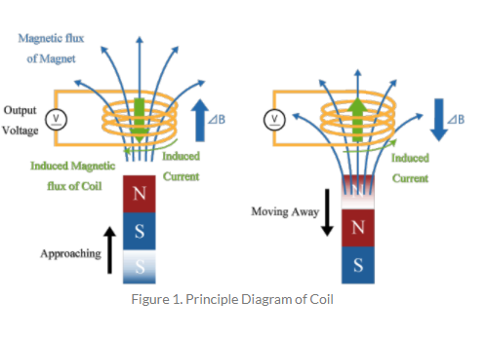
Example of Magnetic field sensor (coils)
Coils are the simplest magnetic sensors that can detect changes of the magnetic flux density

Slide 6
Example of Magnetic field sensor (coils)
when a magnet is brought close to the coil, the magnetic flux density in the coil increases by ΔB.
Then, an induced current that generates a magnetic flux in a direction that hinders an increase in magnetic flux density is generated in the coil.
Conversely, moving the magnet away from the coil reduces the magnetic flux density in the coil, so induced electromotive force and induced current will be generated in the coil to increase the magnetic flux density.

Slide 7
2. Magneto - Elastic sensor
Magnetoelastic sensors are amorphous ferromagnetic ribbons that exhibit a magneto-mechanical resonance when excited by a time varying magnetic field.
Magnetoelastic sensors have successfully been used for stress, pressure, liquid viscosity and density, fluid flow velocity, elasticity, and temperature monitoring.
Based on the fact that, in a longitudinal field, torsion given in a ferromagnetic rod changes its magnetization – Matteucci effect –(Voltage generating property of a twisted ferro-magnetic wire depends upon change of magnetization).

Slide 8
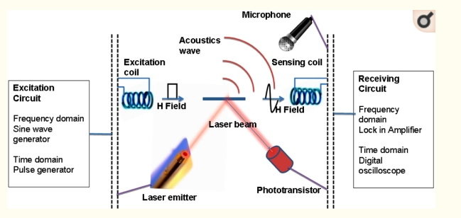
Magneto - elastic sensor

Slide 9
3.Magnetic elastic sensor
Produced using villari effect in which a tensile or compressive stress changes magnetization or affects magnetization in some way.
The inverse magnetostrictive effect, magnetoelastic effect or Villari effect is the change of the magnetization of a material when subjected to a mechanical stress.

Slide 10
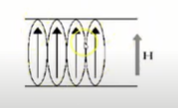
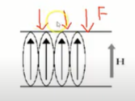
Villari effect
If External magnetic field is applied to ferromagnetic material in vertical direction, the dipoles gets arranged in the same direction
Apply force to Ferromagnetic material

Slide 11
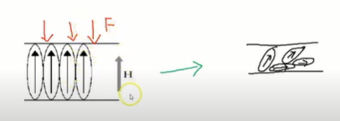
Villari effect
This changes the direction of dipoles. Even though the external magnetic field tries to align the dipoles, the force changes the structure and direction of dipole (random fashion).

Slide 12
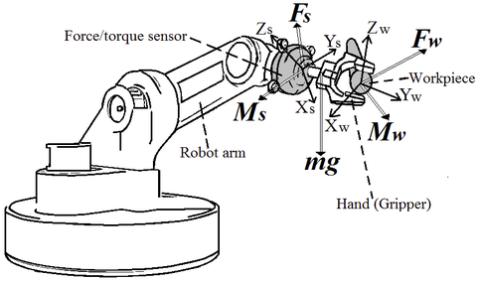
4. Torque/force sensors
A force torque (FT) sensor is an electronic device that is designed to monitor, detect, record and regulate linear and rotational forces exerted upon it.

Slide 13
Torque/force sensors
Wiedemann effect is used to develop the torque/force sensors.
In such sensors, The twisting of a ferromagnetic rod through which an electric current is flowing when the rod is placed in a longitudinal magnetic field

Slide 14
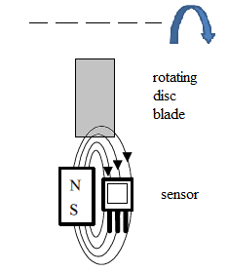
5. Magneto resistive sensors
Becoming increasingly popular, are developed on the basis of ‘Thomson effect’ which is basically a change in resistance of specified materials with magnetic field impressed.
A magneto resistive sensor uses the fact that the electrical resistance in a ferromagnetic thin film alloy is changed through an external magnetic field

Slide 15
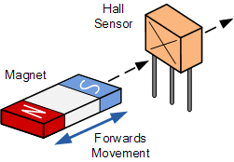
6. Hall effect sensors or magneto galvanic sensors
Most common and widely used type magnetic sensors.

Slide 16
Hall sensor
A Hall effect sensor (or simply Hall sensor) is a type of sensor which detects the presence and magnitude of a magnetic field using the Hall effect.
The output voltage of a Hall sensor is directly proportional to the strength of the field
In a Hall sensor, a current is applied to thin strip of metal. In the presence of a magnetic field perpendicular to the direction of the current, the charge carriers are deflected by the Lorentz force, producing a difference in electric potential (voltage) between the two sides of the strip. This voltage difference (the Hall voltage) is proportional to the strength of the magnetic field.
Hall sensors are used for proximity sensing, positioning, speed detection, and current sensing applications.

Slide 17
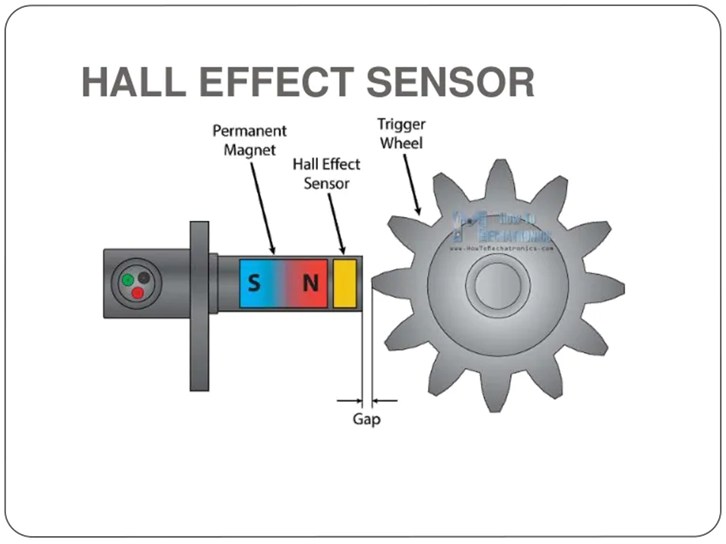
Application of Hall sensor
Voltage produced rotates the gear wheel (in anti lock braking system)

Slide 18
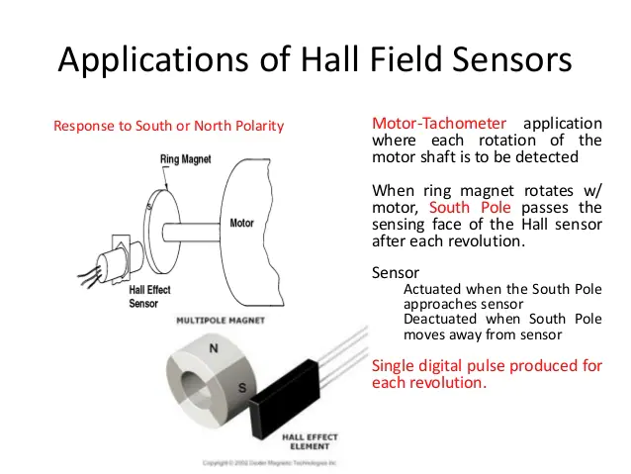

Slide 19
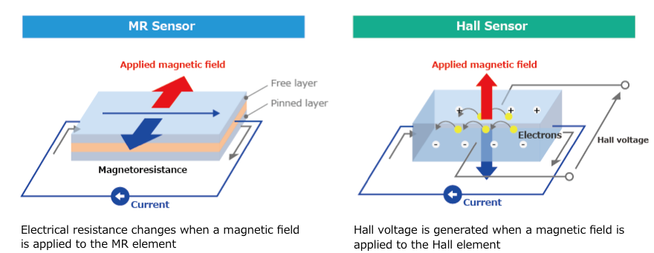
Hall sensor Vs Magnetic sensor
A Hall sensor detects the strength of a magnetic field perpendicular to it,
whereas an MR sensor detects the angle of a parallel magnetic field

Slide 20
7. Distance or proximity sensors
Packed in a small package with low power consumption, this IR proximity sensor allows for continuous distance reading with a range of 10cm to 80cm
Developed based on ‘skin effect’ in which eddy current forces the current flowing through the interior of a material to move to its surface level.
Proximity (nearness in space) of the object is detected by a change in capacitance. The sensor can also be used to detect a wide variety of non-metallic and metallic objects and typically operate over a range of 3 to 30 mm.

Slide 21
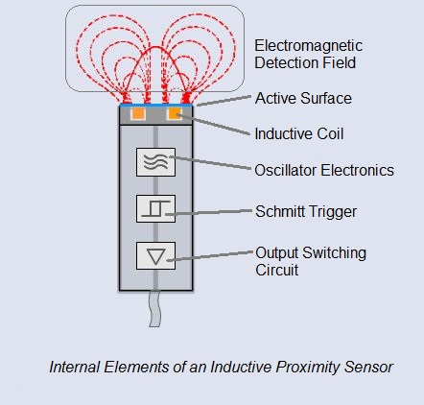
Proximity sensors

Slide 22
8. Wiegand and pulse wire sensors
Tiny devices that use variations in an external magnetic field to generate electrical signals and energy
A specific type of material when subjected to pulse voltages under stress shows switching effect which occurs due to Barkhausen jump.
This is utilized to produce such sensors. The effect is called ‘Sixtus -Tonks effect’ after the experimenter who demonstrated it.

Slide 23
Wiegand and pulse wire sensors
Wiegand sensors are built around small sections of Wiegand wire, a specially prepared ferromagnetic alloy that has a unique physical property.
When exposed to an alternating external magnetic field, a Wiegand wire will initially retaining its magnetic polarity - when the external field reaches a certain threshold, the polarity of the wire segment will abruptly reverse.
This polarity switch occurs within a few microseconds and can generate a distinct current pulse in a fine copper coil wrapped around the ferromagnetic core.
This pulse is strong enough to activate logic circuits and can be used to energize low power electronic chips. This self-powering capacity of Wiegand sensors helps make them more reliable – and safer – since they can provide signals for alarm systems without external power sources. There is no need to check or replace backup batteries, sharply reducing maintenance requirements

Slide 24
9. Superconducting Quantum Interference Devices (SQUIDs)
A SQUID (for superconducting quantum interference device) is a very sensitive magnetometer used to measure extremely subtle magnetic fields, based on superconducting loops containing Josephson junctions. SQUIDs are sensitive enough to measure fields as low as 5×10⁻¹⁴ T
Used for varying application areas, are based on the superconducting state specifically, ‘flux quantization and Josephson effect’.
These types of sensors have a resolution of the order of a few femto Tesla(fT).

Slide 25
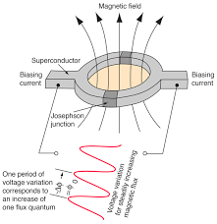
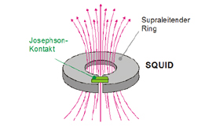
SQUID

Slide 26
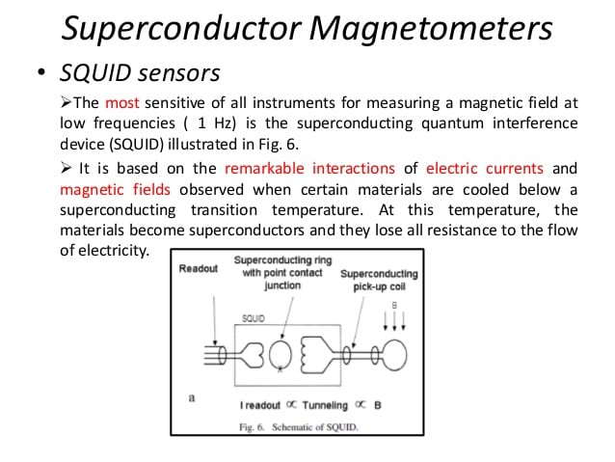

Slide 27
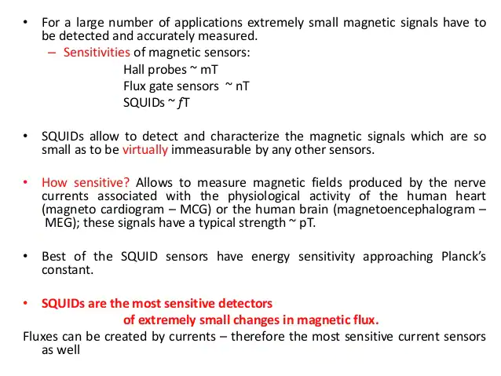

Slide 28
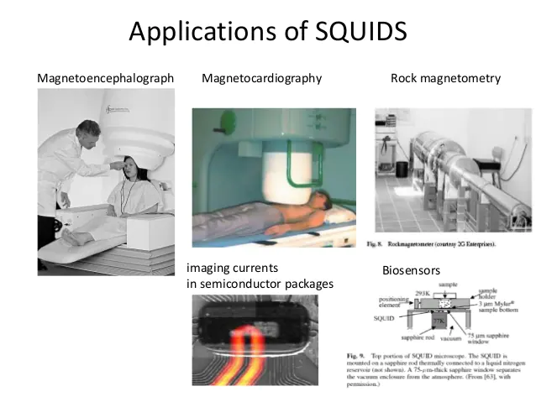

Slide 29
10. Magnetostriction
Magnetostriction is a property of ferromagnetic materials that causes them to change their shape when subjected to a magnetic field.
Phenomenon known over a centuary and half, has been used in combination with piezoelectric elements for field measurements.
This effect is known as ‘Joule effect’ in which magnetization changes the shape of ferromagnetic material body.

Slide 30
Magnetostriction
Magnetostrictive materials are used to convert electromagnetic energy into mechanical energy and vice versa. This effect can be used to create sensors that measure a magnetic field or detect a force.
The magnetic field or force applied would create a strain in the material, which can be measured.
Its magnetic field magnetises the wire axially. Since the two magnetic fields are superimposed, around the float magnet a torsion wave is generated which runs in both directions along the wire.

Slide 31
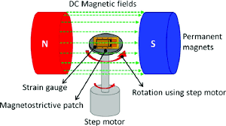
Magnetostriction

Slide 32
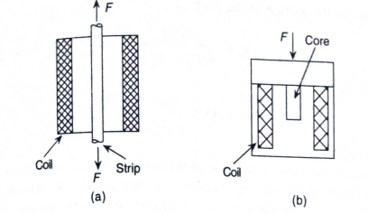
VILLARI Effect
Based on Villari effect, three basic types of magnetoelastic sensors may be designed.
A. The mechanical loading is unidirectional so as to produce compression or tension and this changes the inductance or permeability with the specimen having predefined magnetic flux path, as in choke or coil type design.

Slide 33
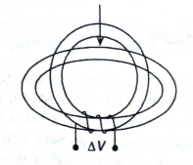
Villari effect
B. Mechanical loading changes the flux in 2 directions or in a plane as in circular rings or laminated cores.
Circular ring is deformed into elliptical form and change in inductance of the ring or change in voltage in the secondary winding ΔV gives the value of the load.

Slide 34
Contd..
In case of laminated core load cells, isotropic magnetic materials are used which become anisotropic under stress due to varying deformation in longitudinal and transverse directions relative to load axis and change in voltage can be derived in ring type design.

Slide 35
Villari effect
C. Loading changes the flux spatially, that is 3 dimensionally in torque transducers for shafts.
If the shaft material does not have the requisite magnetic properties such as magnetostriction, an additional magnetic coating on the shaft surface produces the desired mechanical stress on this surface that is to be measured.

Slide 36
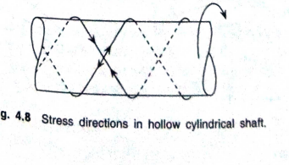
Villari effect
In solid or hollow cylindrical shaft, stress develops in two principal orthogonal directions, one compressive and other tensile, each at angle ±45° with shaft axis in screw like fashion around the shaft (as shown in fig).

Slide 37
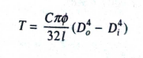
Villari effect
For a hollow shaft of inner and outer diameters Di and Do, the angle of torsion ɸ, the legth of shaft l, torque produced is given by

Slide 38
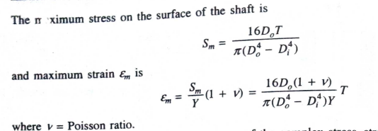
Villari effect

Slide 39
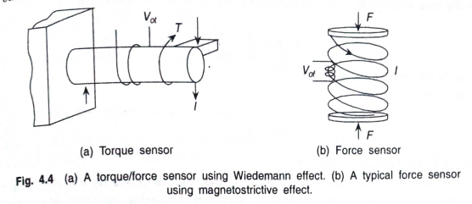
Wiedemann effect
Design principles

Slide 40
Contd..
With a current I passing in direction as shown in fig and a torque is produced in the rod of fig 4.4 a, an output voltage Vot is obtained that gives a measure of the torque.
Fig 4.4.b, Vof is the output voltage for the force in the balanced condition.

Slide 41
Wiedemann effect has 2 inverse effects
When a ferromagnetic rod which is circularly magnetized, is twisted, a longitudinal magnetic field is produced in it
When such a rod with longitudinal magnetization is twisted, a circular magnetic field is produced in it which essentially is matteucci effect.

Slide 42
Hall effect
Also called Galvanomagnetic effect sensor
Observed in metals and semiconductors
When a current is sent through a very long strip of extrinsic homogenous semiconductor in the x direction and across the plane xy perpendicular to it, a magnetic field is applied to produce a flux density Bz, then an electric field Ey in the direction of y is produced which is called Hall field.

Slide 43
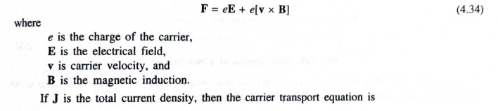
Hall effect
With electrodes across the strip in y direction, a voltage VH called the Hall voltage, can be collected with approximately is given by
Galvanomagnetic effects, arise because of Lorentz force on the charge carrier transport phenomena in condensed medium. Lorentz force is

Slide 44
Hall effect
μH – Hall mobility
J0- current density due to electric field E
Carrier concentration Δn
A magnetic field also affect the electric field potential and carrier concentration and hence it is not justified to write J=J0 and B=0

Slide 45
Hall effect
σ- conductivity
D – diffusion coefficient
Drift – Ist term, Diffusion –IInd term, transverse transport caused by magnetic field – IInd term of eq. 4.35

Slide 46
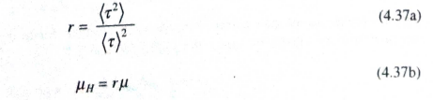
Hall effect
Therefore the transport coefficients μH, σ, D are dependent on electric and magnetic field and are determined by carrier scattering process.
Hall mobility μH is the product of drift mobility of the carrier μ and hall scattering factor r, which is given by appropriate ratio of relaxation time averages of their energy distribution, thus

Slide 47
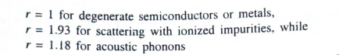
Hall effect
If a long strip of extrinsic and homogenous semiconductor material with xy plane is considered as strip line, where length l is in x direction, with w in y direction and B in z direction, so that B=(0,0,Bz)

Slide 48
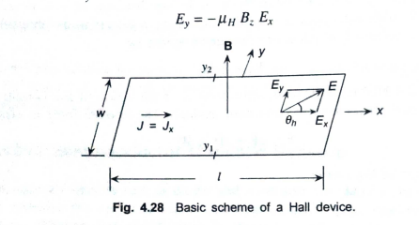
Hall effect
If an external electric field in x direction E=(Ex,0,0) is imposed , a current I with density=(Jx,0,0) will flow in it, so a transverse field Ey builds up for countering the second part of the Lorentz force(4.35).

Slide 49
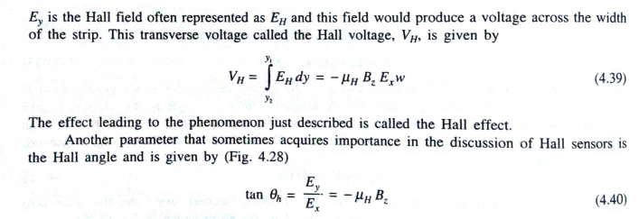
Hall effect

Slide 50
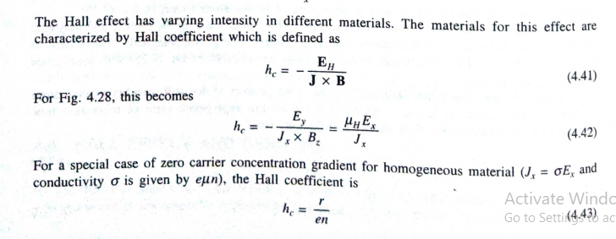
Hall effect

Slide 51
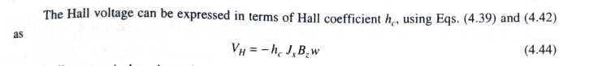
Hall effect

Slide 52
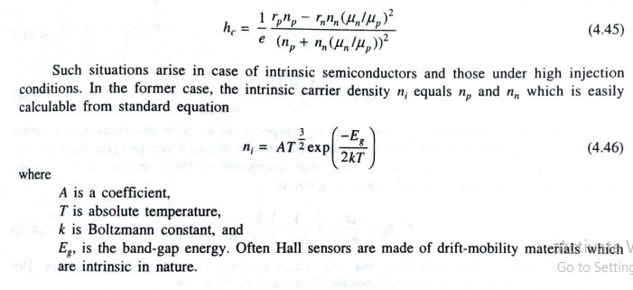
Hall effect

Slide 53
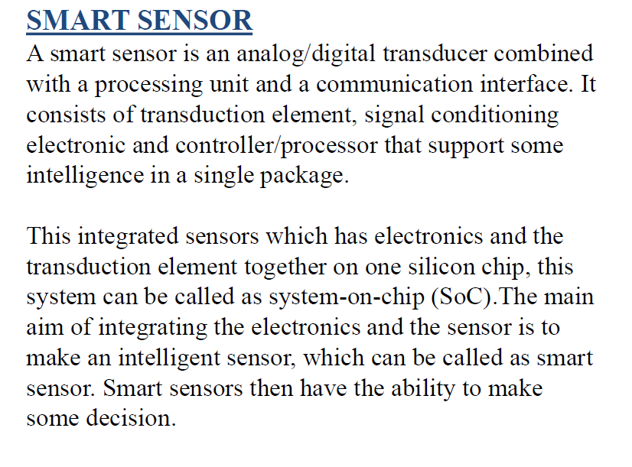

Slide 54
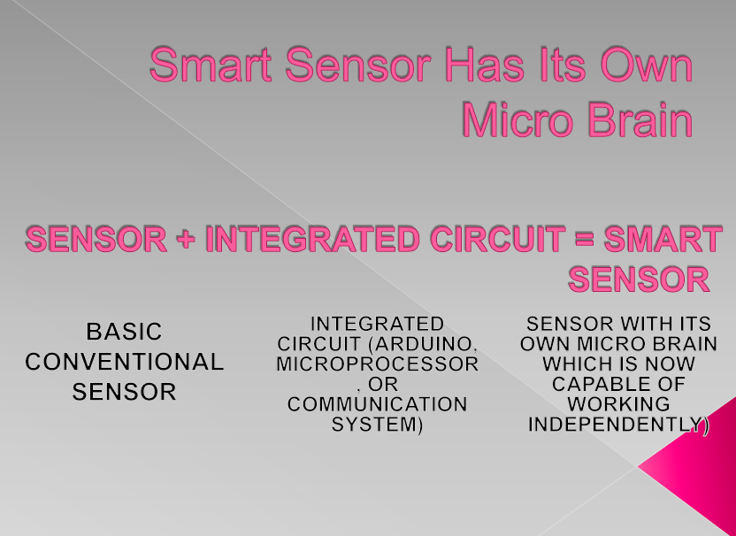

Slide 55
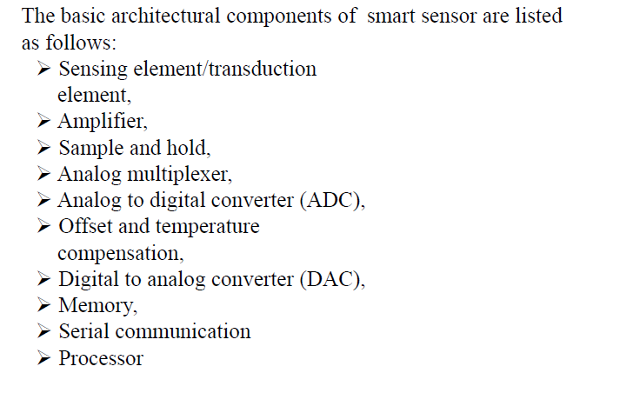
General Architecture of Smart Sensor

Slide 56
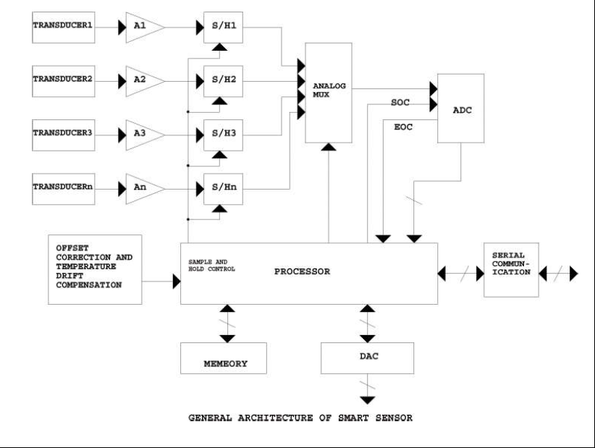

Slide 57
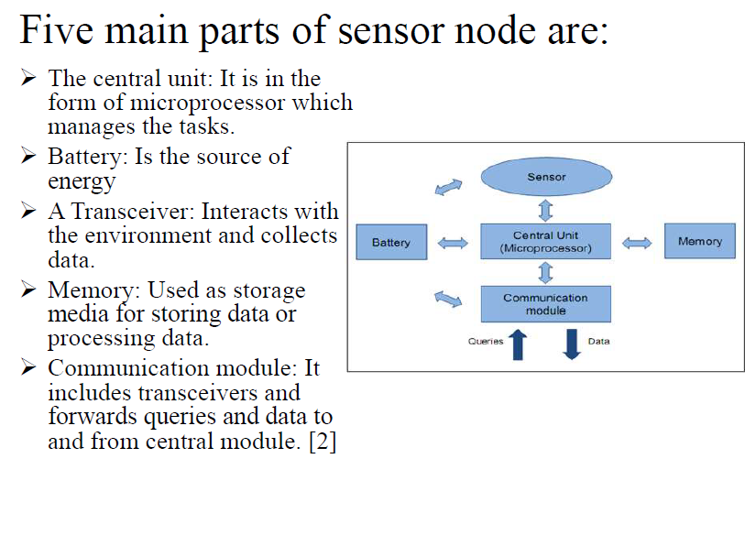

Slide 58
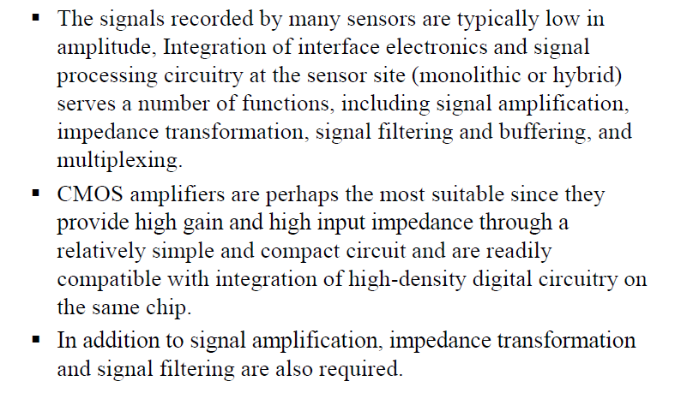
Information Coding/Processing

Slide 59
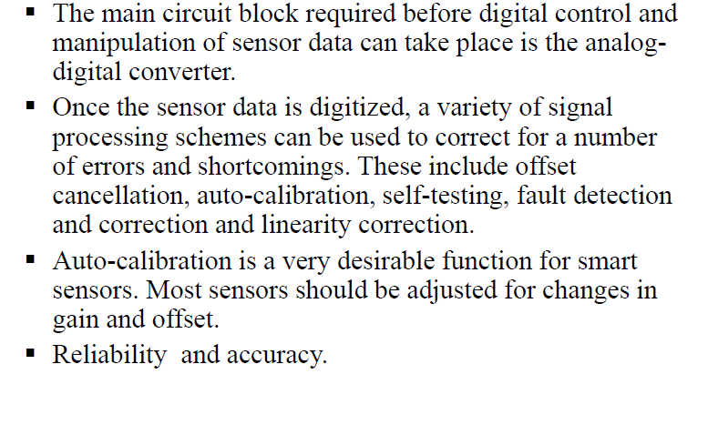
Data Compensation

Slide 60
Top Smart Sensors -
Temperature Sensors
Proximity Sensor
Pressure Sensor
Gas & Smoke Sensor
Accelerometer Sensors
Level Sensors
Image Sensors
Motion Detection Sensors
Optical Sensors
Gyroscope Sensors

Slide 61
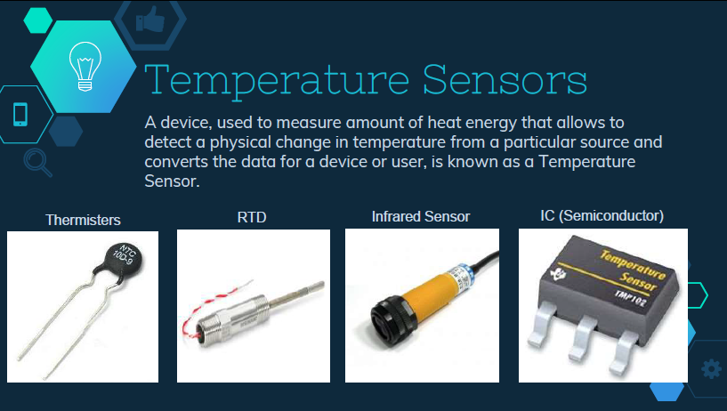
Smart Sensors (Cont..)

Slide 62

Smart Sensors (Cont..)

Slide 63

Smart Sensors (Cont..)

Slide 64

Smart Sensors (Cont..)

Slide 65
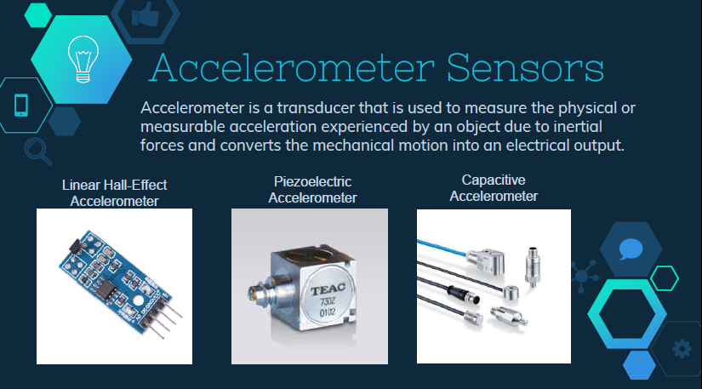
Smart Sensors (Cont..)

Slide 66
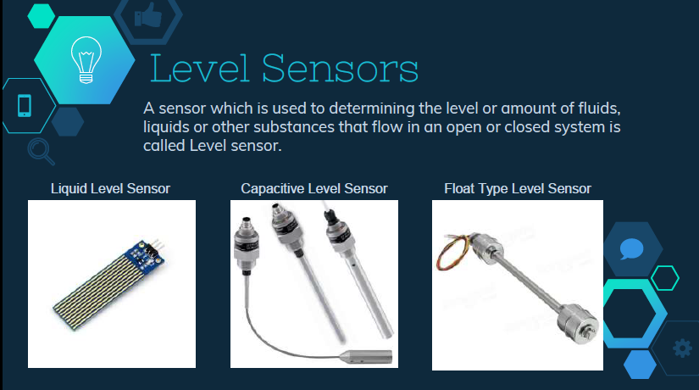
Smart Sensors (Cont..)

Slide 67
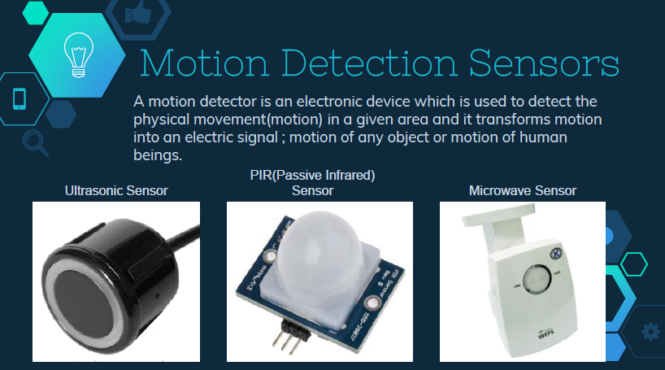
Smart Sensors (Cont..)

Slide 68
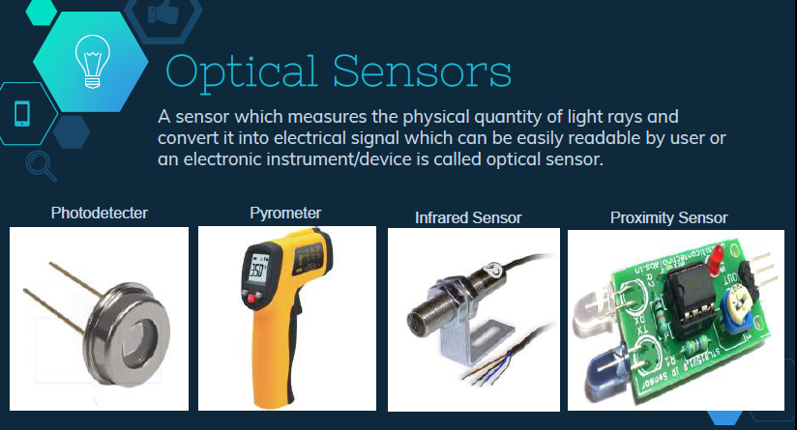
Smart Sensors (Cont..)

Slide 69
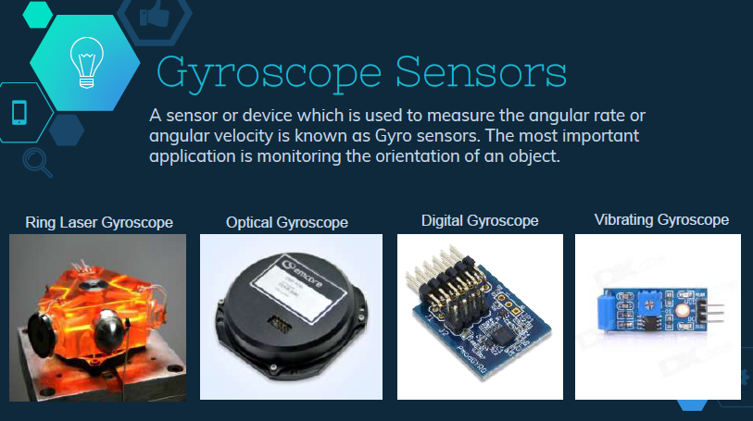
Smart Sensors (Cont..)

Slide 70

Smart Sensors (Cont..)

Slide 71
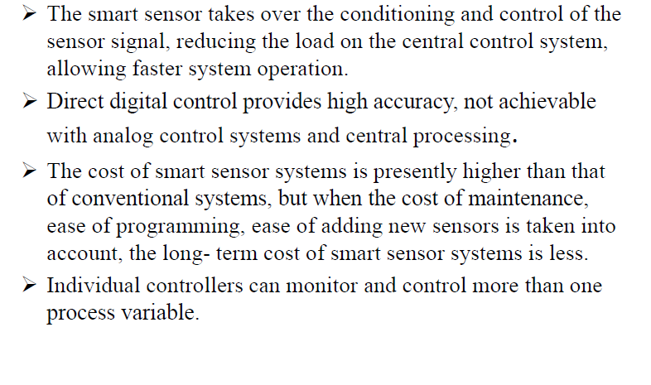
Advantage -

Slide 72
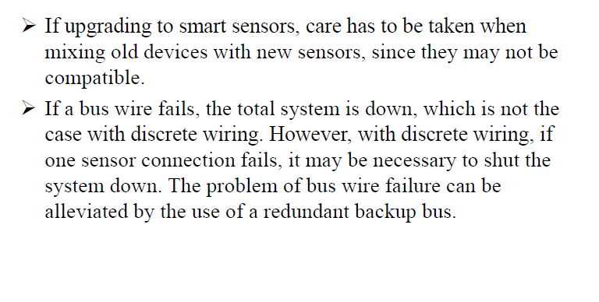
Disadvantages -

Slide 73
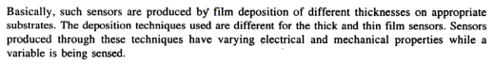
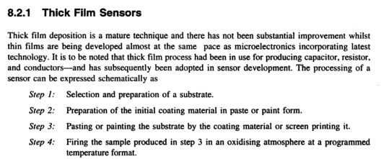
FILM SENSORS

Slide 74
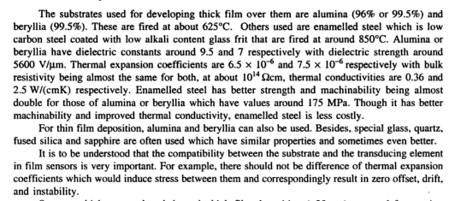

Slide 75


Slide 76


Slide 77


Slide 78



Slide 79
WHAT IS MEMS
MEMS = MicroElectroMechanical System
Any engineering system that performs electrical and mechanical functions with components in micrometers is a MEMS. (1 µm = 1/10 of human hair)
Available MEMS products include:
Micro sensors (acoustic wave, biomedical, chemical, inertia, optical, pressure, radiation, thermal, etc.)
Micro actuators (valves, pumps and microfluidics;electrical and optical relays and switches; grippers, tweezers and tongs;linear and rotary motors, etc.)
Read/write heads in computer storage systems.
Inkjet printer heads.
Micro device components (e.g., palm-top reconnaissance aircrafts, mini robots and toys, micro surgical and mobile telecom equipment, etc.)

Slide 80




Inertia Sensor for Automobile “Air Bag” Deployment System
Micro inertia sensor (accelerometer) in place:
Sensor-on-a-chip: (the size of a
rice grain)
(Courtesy of Analog Devices, Inc)

Slide 81


Micro Cars (Courtesy of Denso Research Laboratories, Denso Corporation, Aichi, Japan)
Rice grains

Slide 82



Miniaturization of Digital Computers - A remarkable case of miniaturization!
Size: 10⁶ down
Power: 10⁶ up
The ENIAC Computer in 1946
A “Lap-top” Computer in 1996
Size: 10⁸ down
Power: 10⁸ up
A “Palm-top” Computer in 2001
This spectacular miniaturization took place in 50 years!!

Slide 83
MINIATURIAZATION – The Principal Driving Force for the 21st Century Industrial Technology
There has been increasing strong market demand for:
“Intelligent,”
“Robust,”
“Multi-functional,” and
“Low-cost”
industrial products.
Miniaturization is the only viable solution to satisfy such market demand

Slide 84




Market Demand for Intelligent, Robusting, Smaller, Multi-Functional Products - the evolution of cellular phones
Mobil phones 10 Years Ago:
Current State-of-the Art:
Size reduction
Palm-top Wireless PC
Transceive voice+ multi-media + others (Video-camera, e-mails, calendar, and access to Internet, GPS and a PC with key pad input)
Transceive voice only
The only solution is to pack many miniature function components into the device

Slide 85

Components of Microsystems
Power Supply
Signal Transduction & Processing
Unit
Sensor
Actuator
Microsystem

Slide 86
Comparison of Microelectronics and Microsystems
Microelectronics | Microsystems (silicon based)
Primarily 2-dimensional structures | Complex 3-dimensional structure
Stationary structures | May involve moving components
Transmit electricity for specific electrical functions | Perform a great variety of specific biological, chemical, electromechanical and optical functions
IC die is protected from contacting media | Delicate components are interfaced with working media
Use single crystal silicon dies, silicon compounds, ceramics and plastic materials | Use single crystal silicon dies and few other materials, e.g. GaAs, quartz, polymers, ceramics and metals
Fewer components to be assembled | Many more components to be assembled
Mature IC design methodologies | Lack of engineering design methodology and standards
Complex patterns with high density of electrical circuitry over substrates | Simpler patterns over substrates with simpler electrical circuitry
Large number of electrical feed-through and leads | Fewer electrical feed-through and leads
Industrial standards available | No industrial standard to follow in design, material selections, fabrication processes and packaging
Mass production | Batch production, or on customer-need basis
Fabrication techniques are proven and well documented | Many microfabrication techniques are used for production, but with no standard procedures
Manufacturing techniques are proven and well documented | Distinct manufacturing techniques
Packaging technology is relatively well established | Packaging technology is at the infant stage
Primarily involves electrical and chemical engineering | Involves all disciplines of science and engineering

Slide 87
Scaling Laws in Miniaturization
In this era of “think small,” one would intuitively simply scale down the size of all components to a device to make it small. Unfortunately, the reality does not work out that way.
It is true that nothing is there to stop one from down sizing the device components to make the device small. There are, however, serious physical consequences of scaling down many physical quantities.
TYPES OF SCALING
Scaling in Geometry
Scaling in Rigid-Body Dynamics
Scaling in Electrostatic Forces
Scaling in Electromagnetic Forces
Scaling in Electricity
Scaling in Fluid Mechanics
Scaling in Heat Transfer

Slide 88
WHY SCALING LAWS?
Miniaturizing machines and physical systems is an ongoing effort in human civilization.
This effort has been intensified in recent years as market demands for:
Intelligent, Robust, Multi-functional and Low cost
consumer products has become more strong than ever.
The only solution to produce these consumer products is to package many components into the product –
making it necessary to miniaturize each individual components.
Miniaturization of physical systems is a lot more than just scaling down device components in sizes.
Some physical systems either cannot be scaled down favorably, or cannot be scaled down at all!

Slide 89

Types of Scaling Laws
Scaling laws become the very first thing that any engineer would do in the design of MEMS and microsystems.
1. Scaling in Geometry:
Scaling of physical size of objects
2. Scaling of Phenomenological Behavior
Scaling of both size and material characterizations

Slide 90
Scaling in Geometry
Volume (V) and surface (S) are two physical parameters that are frequently involved in machine design.
Volume leads to the mass and weight of device components.
Volume relates to both mechanical and thermal inertia. Thermal inertia is a measure on how fast we can heat or cool a solid. It is an important parameter in the design of a thermally actuated device.
Surface is related to pressure and the buoyant forces in fluid mechanics. For instance, surface pumping by using piezoelectric means is a practical way for driving fluids flow in capillary conduits.
When the physical quantity is to be miniaturized, the design engineer must weigh the magnitudes of the possible consequences from the reduction on both the volume and surface of the particular device.

Slide 91


Scaling in Geometry
If we let ℓ = linear dimension of a solid, we will have:
S/V = ℓ⁻¹
A 10 times reduction in length
→ 10³ = 1000 time reduction in volume. But
→ 10² = 100 time reduction in surface area.
The volume:
V ∝ l³
S ∝ l²
The surface:
Since volume, V relates to mass and surface area, S relates to buoyancy force:
S/V ≈ 10⁻⁴/mm
S/V ≈ 10⁻¹/mm
So, an elephant can never fly as easily as a dragonfly!!

Slide 92

Scaling Laws in Miniaturization
Scaling theory is a value guide to what may work and what may not work when we start to design the world of micro.

Slide 93

Range of sizes of objects studied by biochemists and biologists. (Biochemistry by Mathews et al.)

Slide 94
SUBSTRATES AND WAFERS
The frequently used term substrate in microelectronics means a flat macroscopic object on which microfabrication processes take place.
There are two types of substrate materials used in microsystems: (1) active substrate materials and (2) passive substrate materials
Active substrate materials are primarily used for sensors and actuators in a microsystem or other MEMS components(Si,Ge,GaAs,Quartz)

Slide 95
Silicon – an ideal substrate material for MEMS
Silicon (Si) is the most abundant material on earth. It almost always exists in compounds with other elements.
Single crystal silicon is the most widely used substrate material for MEMS and microsystems.
The popularity of silicon for such application is primarily for the following reasons:
It is mechanically stable and it is feasible to be integrated into electronics on the same substrate.Electronics for signal transduction such as the p or n-type piezoresistive can be readily integrated with the Si substrate-ideal for transistors.
Silicon is almost an ideal structure material. It has about the same Young’s modulus as steel ( 2x10⁵ MPa), but is as light as aluminum with a density of about 2.3 g/cm³.

Slide 96
It has a melting point at 1400ºC, which is about twice higher than that of aluminum. This high melting point makes silicon dimensionally stable even at elevated temperature.
Its thermal expansion coefficient is about 8 times smaller than that of steel, and is more than 10 times smaller than that of aluminum.
Silicon shows virtually no mechanical hysteresis. It is thus an ideal candidate material for sensors and actuators. Silicon wafers are extremely flat for coatings and additional thin film layers for either being integral structural parts, or performing precise electromechanical functions.
There is a greater flexibility in design and manufacture with silicon than with other substrate materials. Treatments and fabrication processes for silicon substrates are well established and documented.

Slide 97

Pure silicon wafers
Pure silicon boules of 300 mm diameter and 30 ft long, can weigh up to 400 Kg.
A pure silicon boule
These boules are sliced into thin disks (wafers) using diamond saws.
300 mm wafer
200 mm wafer
Standard sizes of wafers are:
100 mm (4”) diameter x 500 μm thick.
150 mm (6”) diameter x 750 μm thick.
200 mm (8”) diameter x 1 mm thick
300 mm (12”) diameter x 750 μm thick (tentative).

Slide 98
SI WAFER PRODUCTION, CZ PROCESS, (S3)

Slide 99
SI WAFER PRODUCTION STEPS
Crystal Growth and Wafer Slicing Process
Thickness Sorting
Lapping & Etching Processes
Thickness Sorting and Flatness Checking
Polishing Process
Final Dimensional and Electrical Properties Qualification

Slide 100


Crystal Growth and Wafer Slicing Process
Step 1: Obtaining the Sand
The sand used to grow the wafers has to be a very
clean and good form of silicon.
Step 2: Preparing the Molten Silicon Bath
It is heated to about 1600 degrees C – just above its
melting point(1400 degrees C) The molten sand will become the source of the silicon that will be the wafer.

Slide 101

Step 3: Making the Ingot
A silicon seed crystal is now placed into the molten sand bath. This crystal will be pulled out slowly as it is rotated. The result is a pure silicon cylinder that is called an ingot pure.
The diameter of the silicon ingot is determined by the temperature variables as well as the rate at which the ingot is withdrawn
Each of the wafers is given either a notch or a flat edge that will be used later in orienting the wafer into the exact position for later procedures
Step 4: Preparing the Wafers
After the ingot is ground into the correct
diameter for the wafers, the silicon ingot is
sliced into very thin wafers.
This is usually done with a diamond saw.

Slide 102

Thickness Sorting
Following slicing, silicon wafers are often sorted on an automated basis into batches of uniform thickness to increase productivity in the next process step, lapping .
During thickness sorting, the wafer manufacturer can also identify defect trends resulting from the slicing process

Slide 103

Lapping & Etching Processes
Lapping removes the surface silicon which has been cracked or otherwise damaged by the slicing process, and assures a flat Surface.
Wafers are then etched in a chemically active reagent to remove any crystal damage remaining from the previous process step.
Thickness Sorting and Flatness Checking
Following lapping or etching, silicon wafers are measured for flatness to identify and control defect trends resulting from the lapping and etching processes
Wafers are also often sorted on an automated basis according to thickness in order to increase productivity in the next process step, polishing.

Slide 104


Polishing Process
Polishing is a chemical/mechanical process that smoothes the uneven surface left by the lapping and etching processes and makes the wafer flat and smooth enough to support optical photolithography
A wafer polishing machine
Wafers in storage trays

Slide 105
Nano Sensor

Slide 106

Size and Compatibility

Slide 107

Size and Compatibility

Slide 108
Why Nanosensors
Particles that are smaller than the characteristic lengths associated with the specific phenomena often display new chemistry and new physics that lead to new properties that depend on size
When the size of the structure is decreased, surface to volume ratio increases considerably and the surface phenomena predominate over the chemistry and physics in the bulk
The reduction in the size of the sensing part and/or the transducer in a sensor is important in order to better miniaturise the devices
Science of nano materials deals with new phenomena, and new sensor devices are being built that take advantage of these phenomena
Sensitivity can increase due to better conduction properties, the limits of detection can be lower, very small quantities of samples can be analysed, direct detection is possible without using labels, and some reagents can be eliminated.

Slide 109
Types of Nanosensors
NanoSensors
Optical Nanosensors
Chemical Nanosensors
Physical Nanosensors
Biological Nanosensors
Proximity Nanosensors
Ambient Light Nanosensors
Antibody/Antigen Interaction
DNA Interaction
Enzymatic Interaction
Chemical Composition
Molecular Concentration
Pressure
Force
Mass
Displacement

Slide 110

Optical Sensors- Proximity Sensors
Proximity sensors are designed for use in detecting the presence of an object or motion detection in various industrial, mobile, electronic appliances and retail automations.
Examples of proximity sensor usage include the detection of an out-of-paper condition in a printer or a mobile phone screen that dims to save battery life when placed near a face.

Slide 111


Optical Sensors- Ambient Light Sensors
Ambient light sensors provide precise light detection for a wide range of ambient brightness and are commonly used in LCD backlight control in mobile phones, LCD TV/panel, and notebook applications.
One way to convert the optical signal is by using electro-optical sensors - electronic detectors that convert light, or a change in light, into an electronic signal. Light has many components that can be sensed, such as the wavelength, the intensity, the polarization and the phase. The interaction of light with matter can be quantified by measuring absorbance, reflectance, luminescence and more.

Slide 112


Bio-Nanosensor

Slide 113
Biosensors
• Biosensor: analytical device for measurement of a specific analyte
•biological material + physicochemical transducer(electrochemical, optical, thermometric, piezoelectric,magnetic or micromechanical)
• Nanomaterials and nanosensors increase sensitivity and detection level to pico-, femto-, atto- and even zepto- scales (10^-12-10^-21) – this facilitates helps in early disease detection.
• Biomarkers, molecules with a function indicating physiologic or pathologic state, interact with specific receptors fixed onto the surface of a biosensor transducer.

Slide 114

“A biosensor is an analytical device incorporating a biological or biologically derived sensing element either intimately
associated with or integrated within a physicochemical transducer. The usual aim is to produce a digital electronic signal
which is proportional to the concentration of a specific analyte or group of analytes”

Slide 115

Chemical Nanosensors
Chemical sensors usually contain two basic components connected in series: a chemical (molecular) recognition (receptor) and a physicochemical transducer. In the majority of chemical sensors, the receptor interacts with the analyte molecules. As a result, the physical properties are altered in such a way that the appending transducer can gain an electrical signal. In some cases, a single physical object acts as a receptor and as a transducer.
Illustration of chemiresistors with receptors, the binding of bio-molecule with net electrical charges changes the channel conductance.

Slide 116
Physical Nanosensors
The physical nanosensor sense the environmental physical change such as
Force
Acceleration
Flow rate
Mass
Volume
Density
pressure
Nanoindentor:The force range is up to 500 μN and 1 mN for the two main designs, with a force resolution of to 0.3 μN.
CNT force sensor

Slide 117

Applications of Nanosensors

Slide 118

LOAD CELLS

Slide 119


Slide 120


Slide 121


Slide 122


Slide 123


Slide 124


Slide 125


Slide 126


Slide 127


Slide 128


Slide 129


Slide 130


Slide 131


Slide 132


Slide 133


Slide 134


Slide 135


Slide 136


Slide 137


Slide 138


Slide 139


Slide 140


Slide 141


Slide 142


Slide 143


Slide 144


Slide 145


Slide 146


Slide 147


Slide 148


Slide 149


Slide 150


Slide 151


Slide 152


Slide 153


Slide 154


Slide 155


Slide 156


Slide 157


Slide 158


Slide 159


Slide 160


Slide 161


Slide 162


Slide 163




Slide 164




Slide 165


Slide 166


Slide 167


Slide 168




Slide 169



Slide 170


Slide 171


Slide 172


Slide 173


Slide 174


Slide 175


Slide 176


Slide 177


Slide 178


Slide 179


Slide 180


Slide 181


Slide 182


Slide 183

WEIGH FEEDER SYSTEM

Slide 184


Slide 185


Slide 186


Slide 187


Slide 188


Slide 189


Slide 190


Slide 191


Slide 192


Slide 193


